Slide 1
Effort Level Search in Infinite Completion Trees with Application to Task and Motion Planning
Marc Toussaint, Joaquim Ortiz de Haro, Valentin Noah Hartmann, Erez Karpas, and Wolfgang Hoenig
ICRA 2024, Yokohama, May 13-17

Slide 2
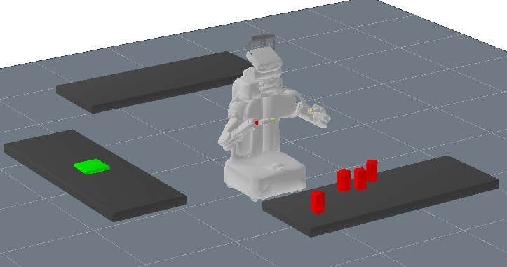
Solving Task and Motion Planning
pick(A), stack(A,B), pick(C)
pick(C), stack(C,A), pick(D)
Logical
plan (A*)
1
4
2
Waypoints
(NLP)
4
5
3
3
4
4
2
Collision free path
(RRT)
7
8
9
7
6
8
Joint motion
(NLP)
6
3
4
Solving each node has a computational cost
Each node has several possible successors
Some node computations may not have completed
Some nodes have an infinite branching factor

Slide 3
Typical TAMP Algorithm Pseudo-Code
Do we want to keep manually developing pseudo codes like this?
Long-Horizon Multi-Robot Rearrangement Planning for
Construction Assembly, Hartmann et al. TRO’22
RHH-LGP: Receding Horizon And Heuristics-Based Logic-Geometric Programming For Task And Motion Planning, Braun et al. IROS’22

Slide 4
Search in Task and Motion Planning
Algorithm design for TAMP (and other hybrid problems) is hard!
Search over discrete decisions combined with continuous solvers to check feasibility
Interleave path finding, manipulation constraint solving, trajectory optimization, etc.
When do we give up path optimization and switch to RRT?
When do we give up with RRT and call it infeasible?
When do we give up sampling waypoints?
The algorithm itself should decide where to invest the next unit of compute time

Slide 5
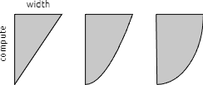
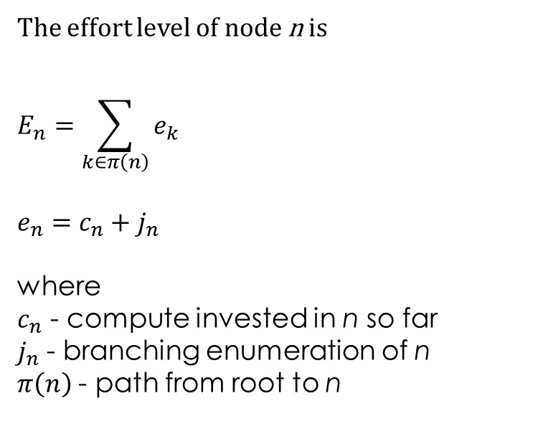

Effort Level Search (ELS)
The effort level of node n is
$$E_{n}=\sum_{k∈π\left(n\right)}{e_{k}}$$
$$e_{n}=c_{n}+j_{n}$$
where
$c_{n}$ - compute invested in n so far
$j_{n}$ - branching enumeration of n
$π\left(n\right)$ - path from root to n
pick(A), stack(A,B), pick(C)
pick(C), stack(C,A), pick(D)
1
4
2
2+1
1+2
4+3
4
5
3
3
4
4
2
2+1
4+1
2+1
5+2
2+1
3+3
2+1
3+4
1+2
4+1
7
8
9
7
6
8
6
3
4
$$e_{n}={\left(\frac{c_{n}}{c_{0}}\right)}^{p_{c}}+{\left(\frac{j_{n}}{w_{0}}\right)}^{p_{w}}+e$$

Slide 6
Effort Level Search (ELS)
Essentially – breadth first search over infinite search trees
Instead of just expanding nodes, we have widen, deepen, and compute
Guarantees completeness – if an optimal solution exists, it will be found
  Possibly, suboptimal solutions will be found before it
Generalizes round-robin, budgeted bandits, …

Slide 7

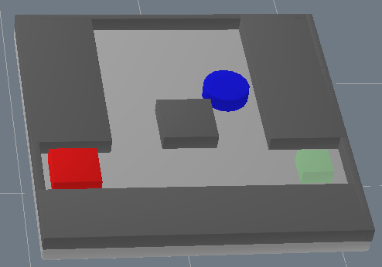
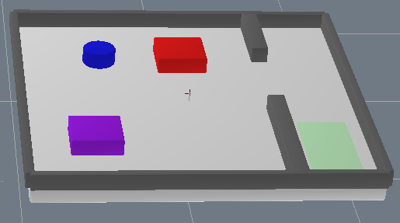
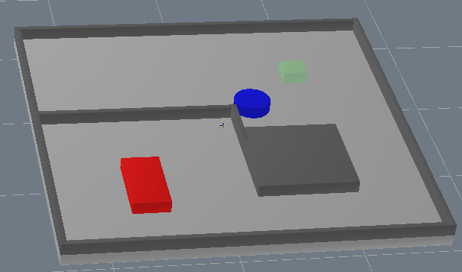
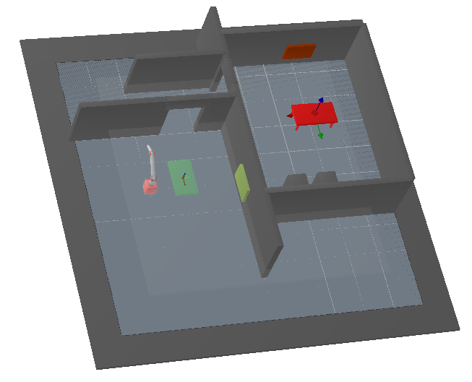
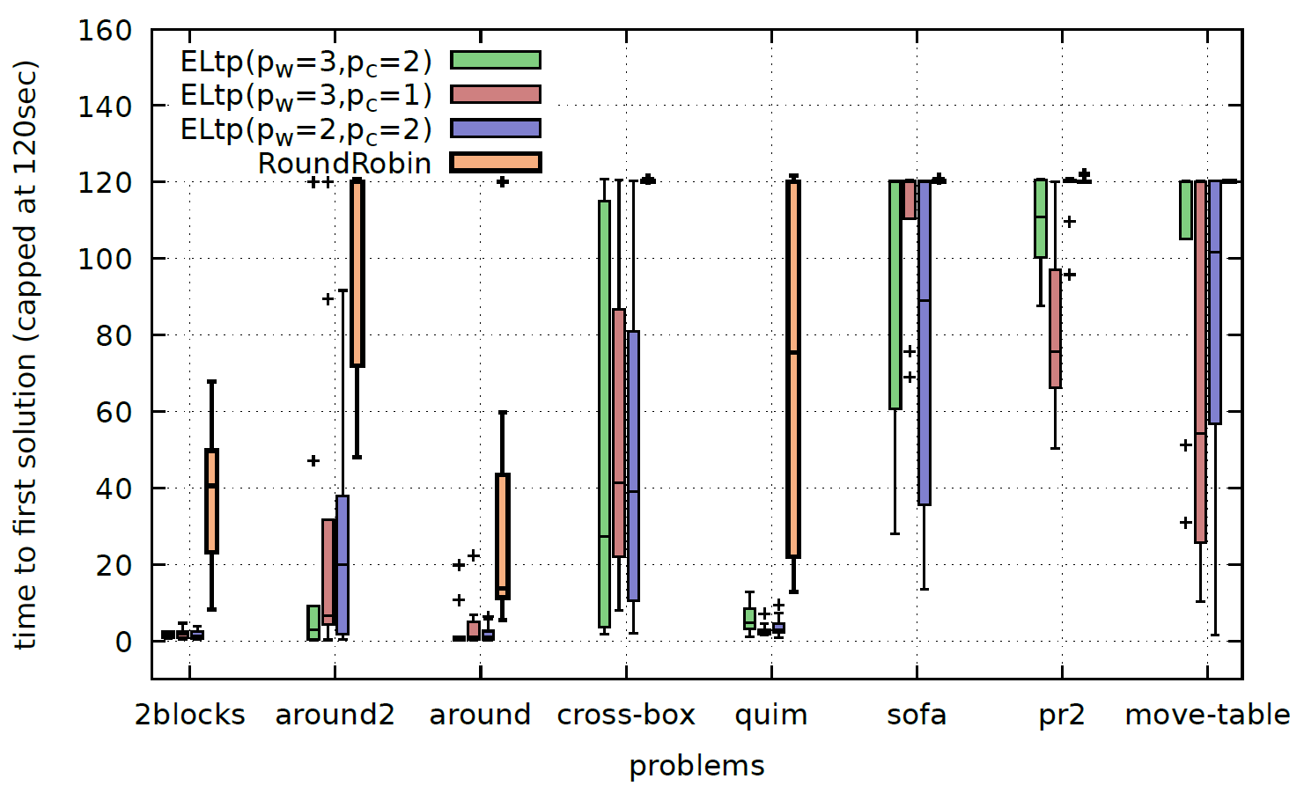
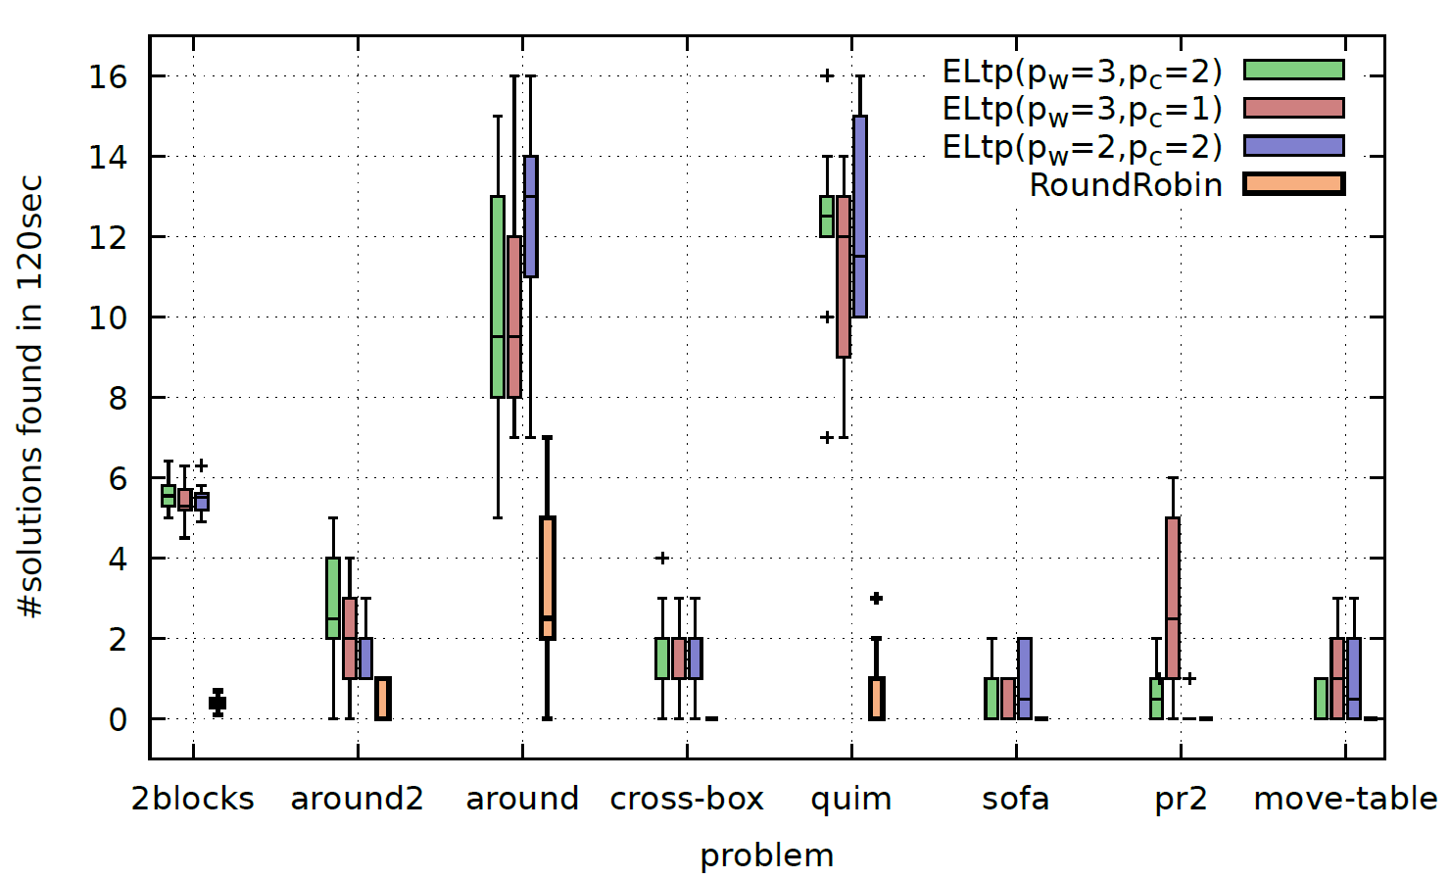
Empirical Evaluation - TAMP
Time to first solution
#solutions in 120 seconds

Slide 8
Conclusion
Effort Level Search is a new way to search through trees with an infinite branching factor
Challenge: better search guidance
Thank you
Questions?

